Slide 1
Introduction to
Single Cell RNA-Seq (scRNA-seq)
Basil Khuder
Senior Bioinformatician
UAB Biological Data Science Core

Slide 2
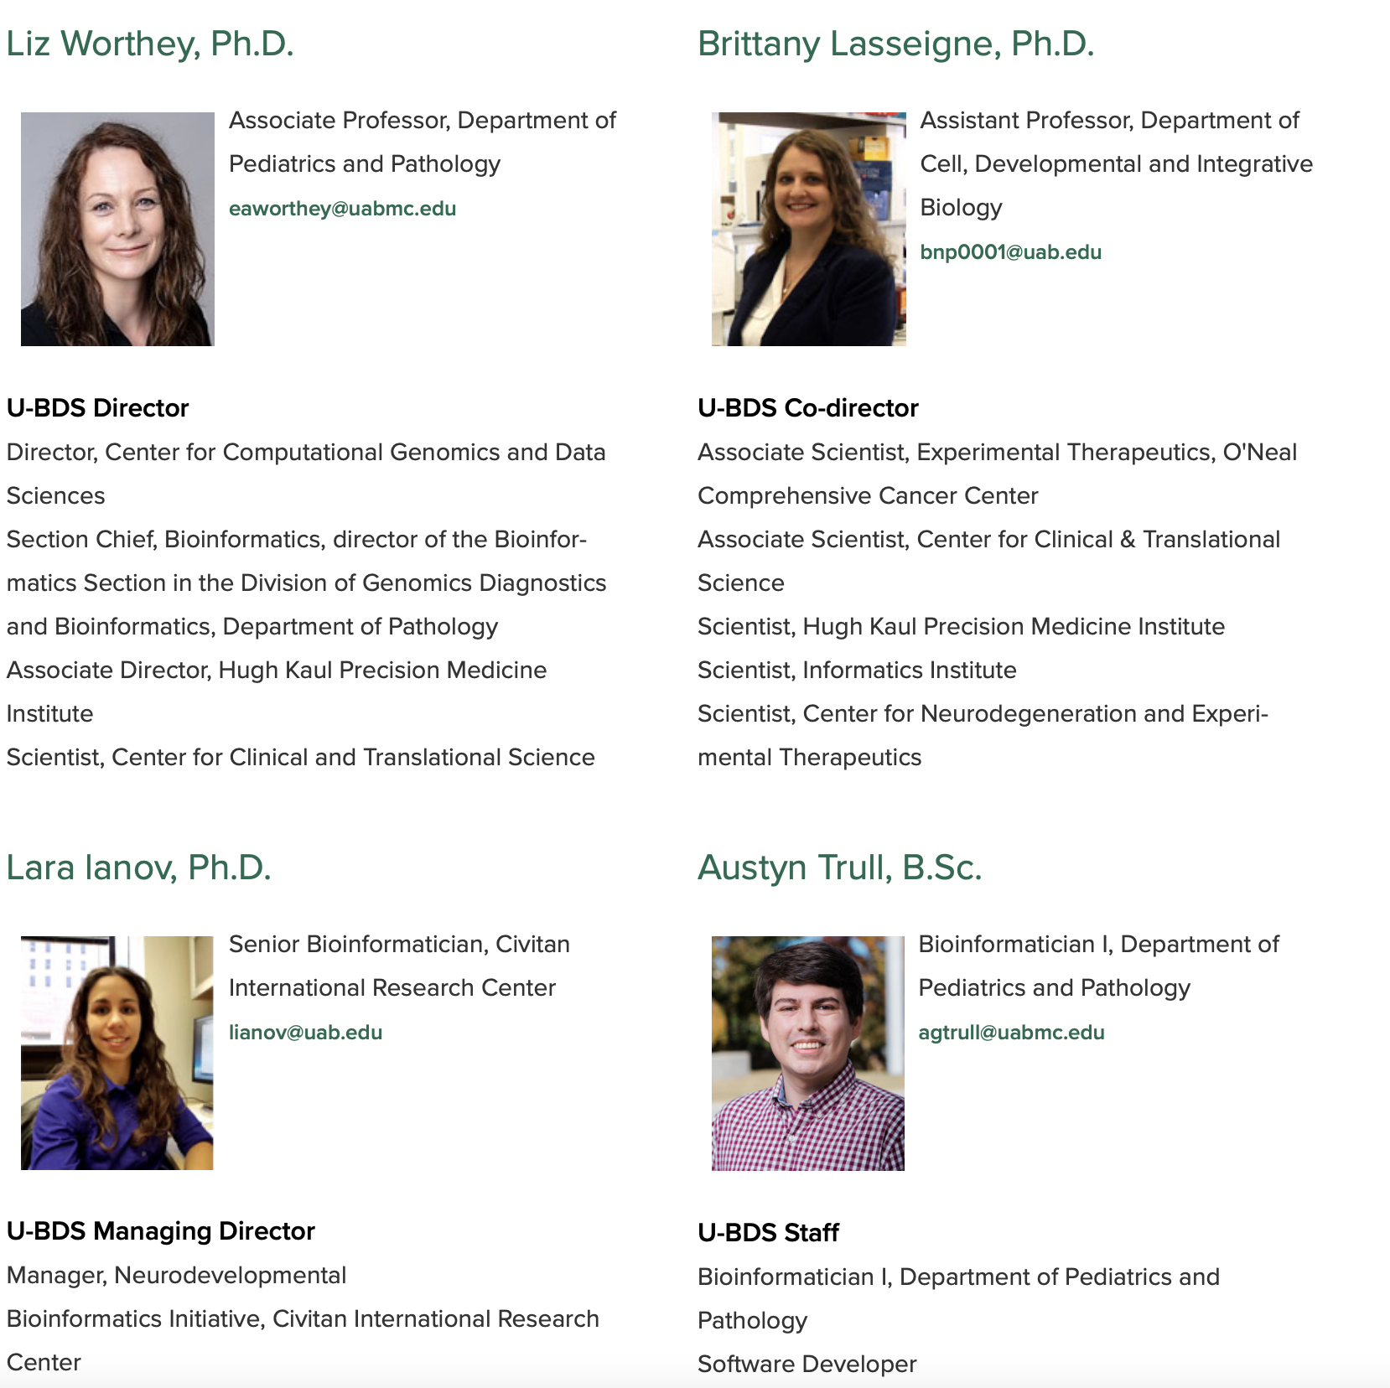
U-BDS Core Members

Slide 3
Overview
What is Single-Cell RNA-Seq?
Most commonly used technologies/platforms
Overview of Computational Biology Methods
Secondary Analysis
10X Cell Ranger (commercially based pipelines)
STARSolo, Alevin (Alevin-fry), kallisto bustools (scientific community)
Tertiary Analysis
Seurat/Scanpy
Steps to analyze data
Quality control, normalization, dimensionality reduction, cluster identification, data projection, differential expression

Slide 4
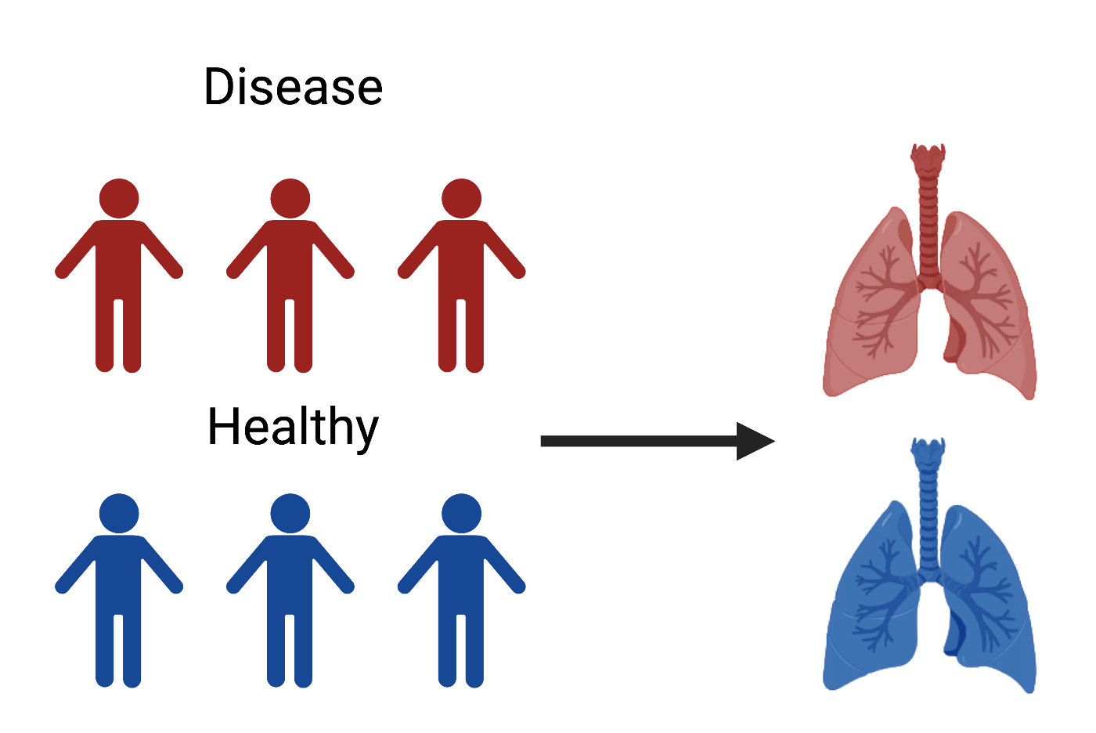
Let’s Pretend…
We’re researchers looking to develop new therapeutics to target an inflammatory lung disease
Cohort of six individuals
(3 healthy, 3 disease)

Slide 5
Let’s Pretend…
We have the option of running a single-cell RNA seq analysis or bulk RNA-seq
We have chosen to go with single-cell…
But why?

Slide 6
Recall from Thursday
Bulk RNA-Seq (or simply “RNA-Seq”)
Gives us the average expression across all cells within a tissue type
Confounds any variability within cell-types
Gives a high-level picture of the transcriptional landscape
Cheaper than single-cell

Slide 7
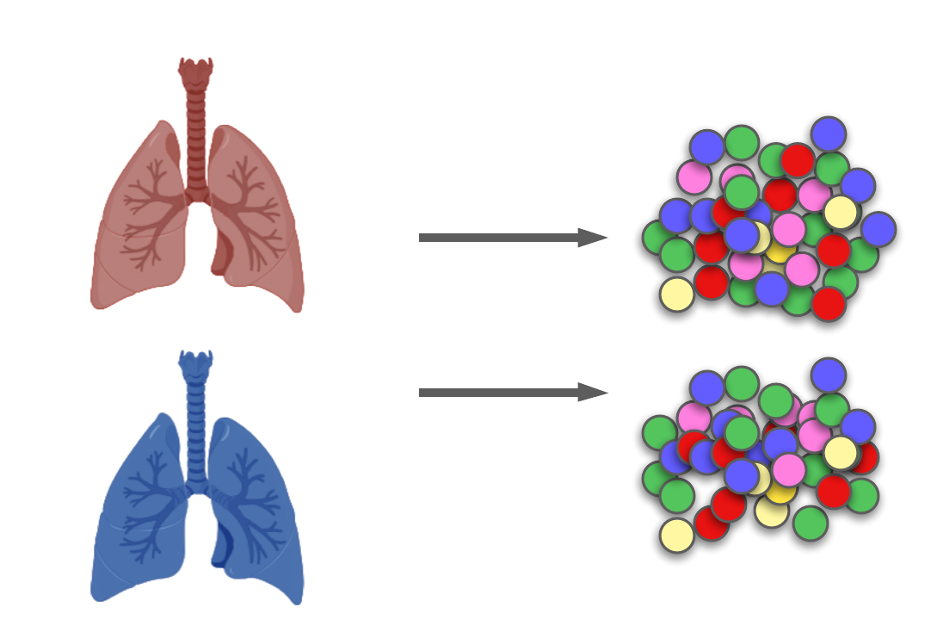
All Cells Are Not Created Equal
Lung tissue is comprised of multiple different cell types (over 40..)
Bulk RNA-Seq doesn’t tell us which cells are the primary drivers of inflammatory gene expression
Identifying cell-specific expression can lead to a more targeted therapeutic

Slide 8
All Cells Are Not Created Equal
Through a method called Pseudobulk, we can still answer fundamental question of disease/non-disease and emulate a bulk RNA-seq using single-cell
We’ll touch on this later…

Slide 9
Some More Questions scRNA-Seq Can Answer…
How does the cellular landscape of healthy individuals differ?
Are there novel inflammatory cell populations in the disease group?

Slide 10
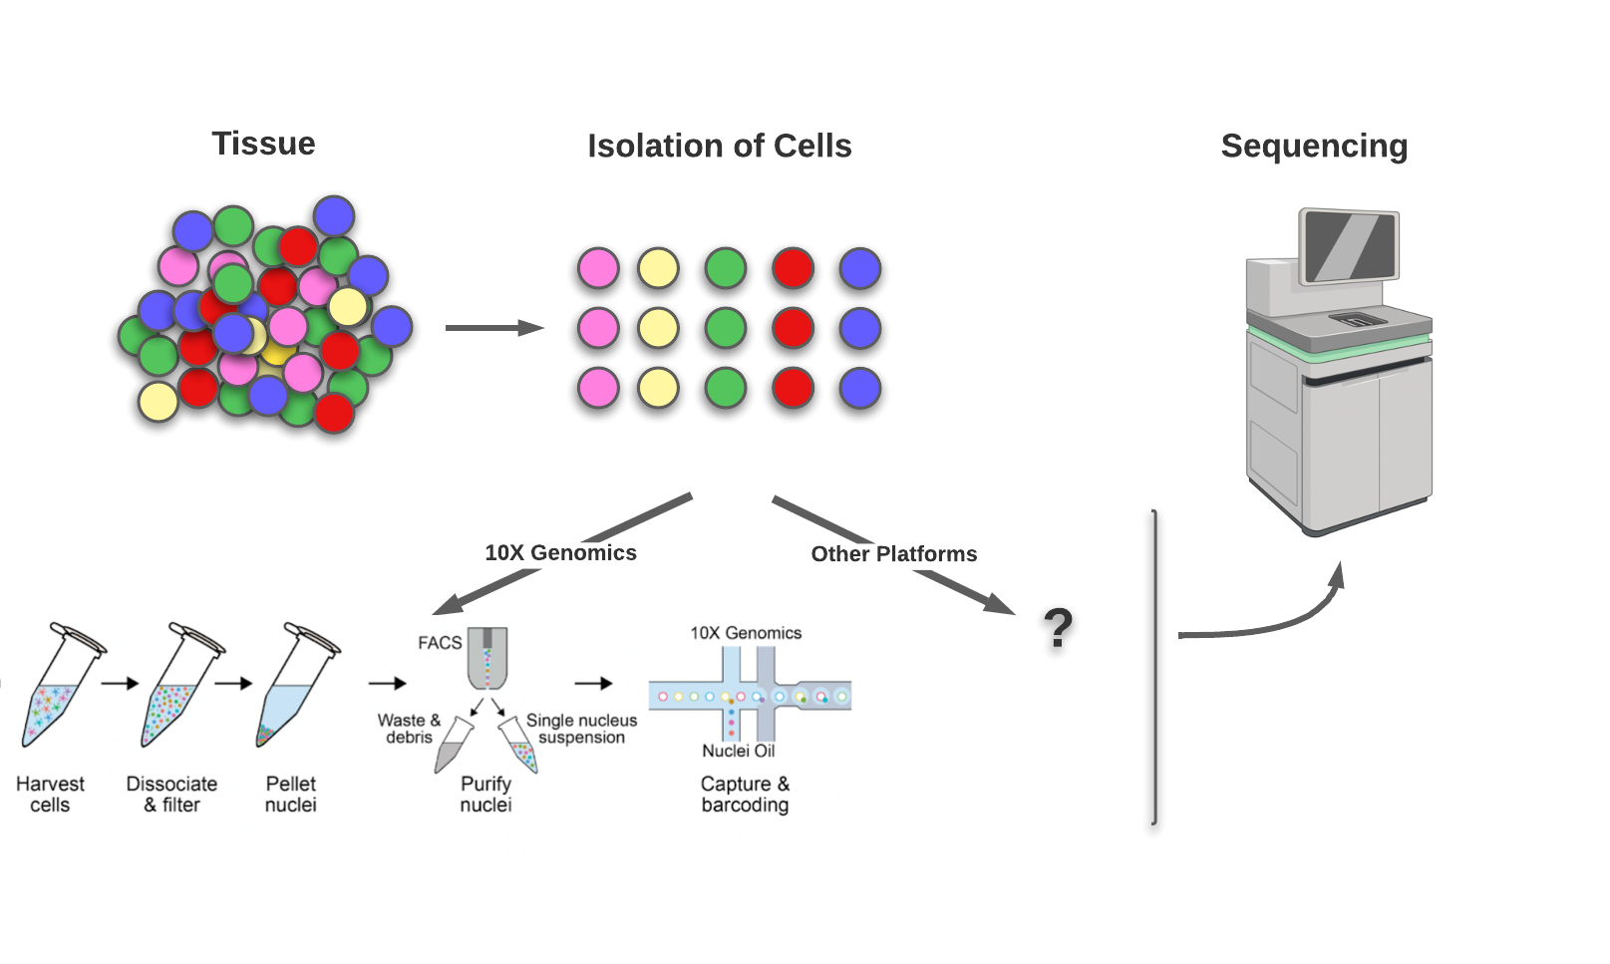
The Process
Katherine E. Savell*, Jennifer J. Tuscher*, Morgan E. Zipperly*, Corey G. Duke*, Robert A.Phillips III*, Allison J. Bauman, Saakshi Thukral, Faraz A. Sultan, Nicholas A. Goska, Lara Ianov, Jeremy J. Day (Science Advances, June, 2020). A dopamine-induced gene expression signature regulates neuronal function and cocaine response DOI: 10.1126/sciadv.aba4221

Slide 11
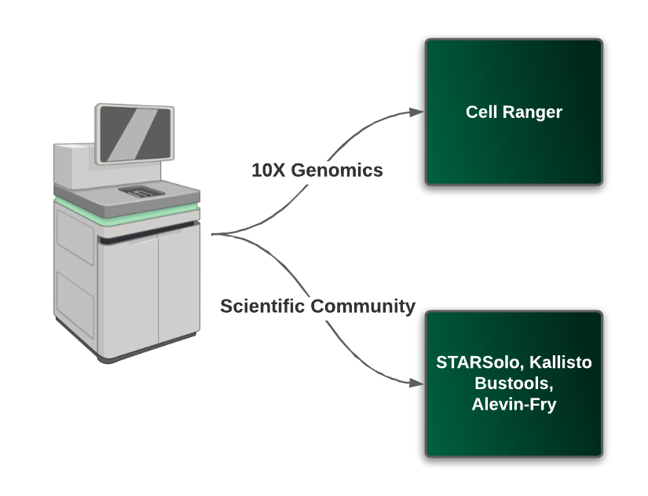
The Process

Slide 12
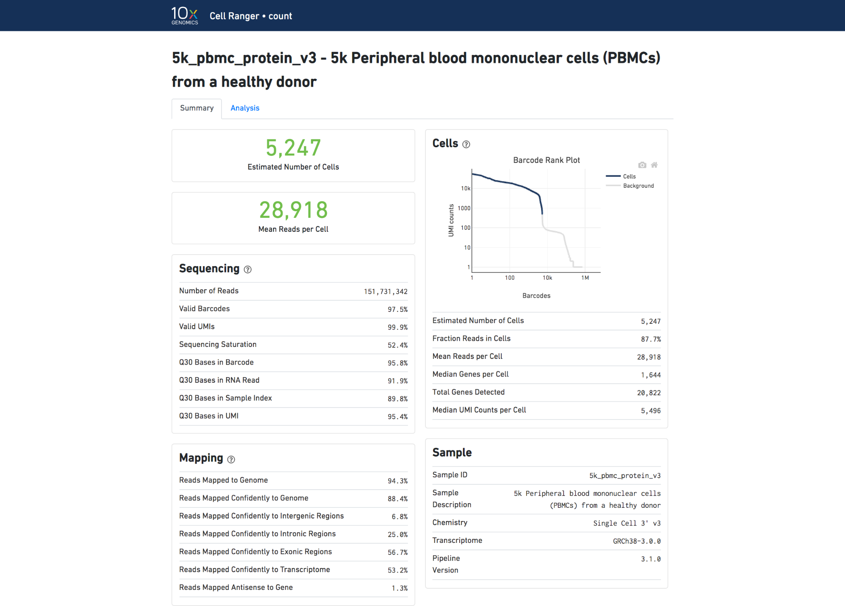
Single-Cell RNA-Seq - 10X Genomics

Slide 13
Single-Cell RNA-Seq - 10X Genomics

Slide 14
Single-Cell RNA-Seq - 10X Genomics
Shows distribution of counts and which cells are associated with barcodes.
We want to see a steep drop from the cells to the background.
Indicates good separation.

Slide 15
Single-Cell RNA-Seq - 10X Genomics

Slide 16
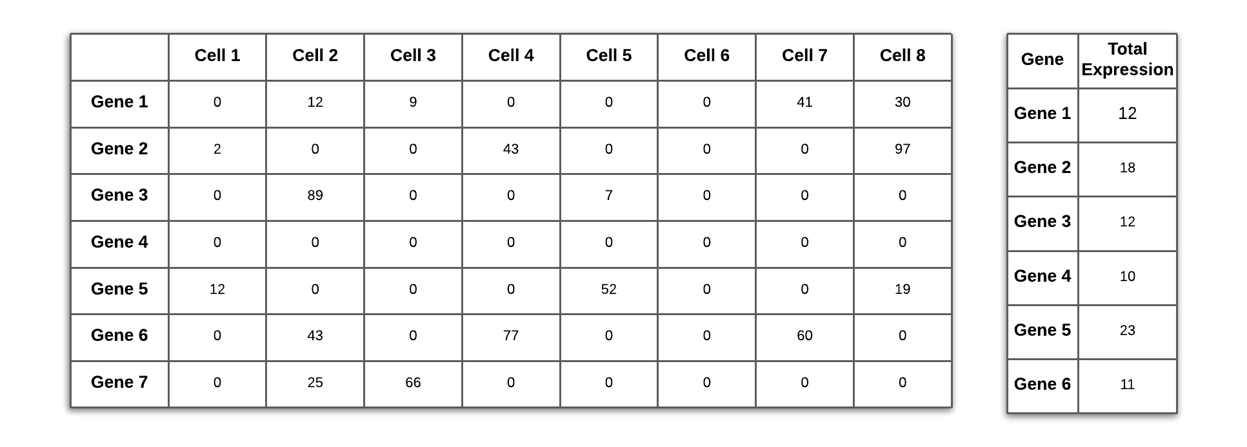
The Process

Slide 17
scRNA-Seq vs Bulk RNA-Seq Gene Matrix

Slide 18
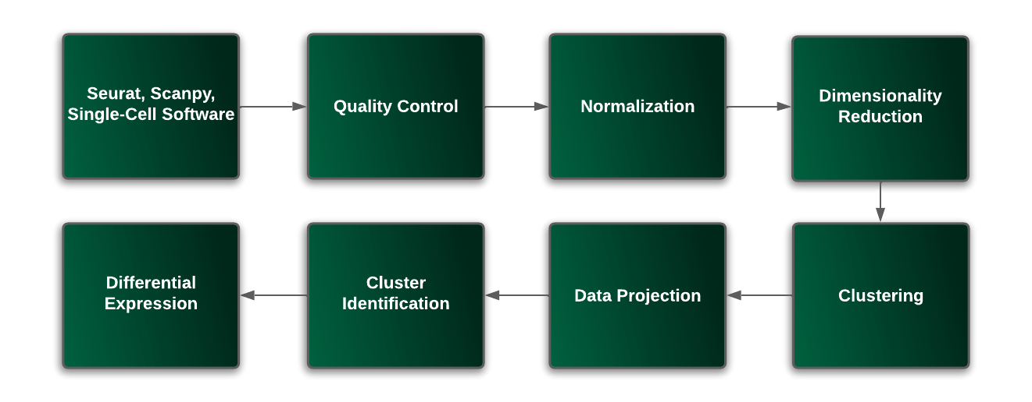
Roadmap

Slide 19
Tertiary Analysis
Seurat: R based package for analyzing single-cell data.
Scanpy: Python based package for analyzing single-cell data
Both employ similar methods,
Slight differences in certain algorithms/methods that some their functions use.

Slide 20
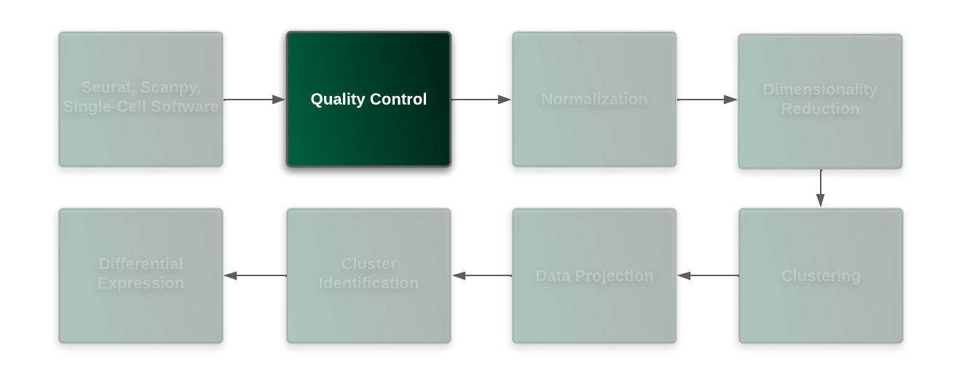
Roadmap (Quality Control)

Slide 21
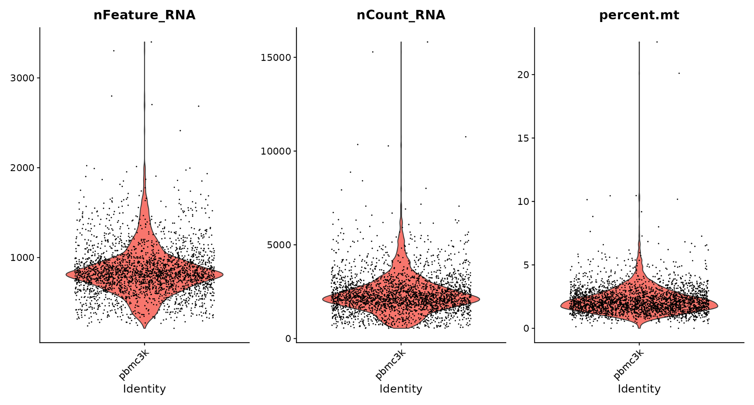
Roadmap (Quality Control)
QC for single-cell is data-driven
Variable depending on data-type

Slide 22
Roadmap (Quality Control)
> 2500 features
< 200 features

Slide 23
Roadmap (Quality Control)
> 5% MT
Again variable, cardiomyocytes will have higher percentage MT, etc
Note: more QCs should be performed beyond what is shown here

Slide 24
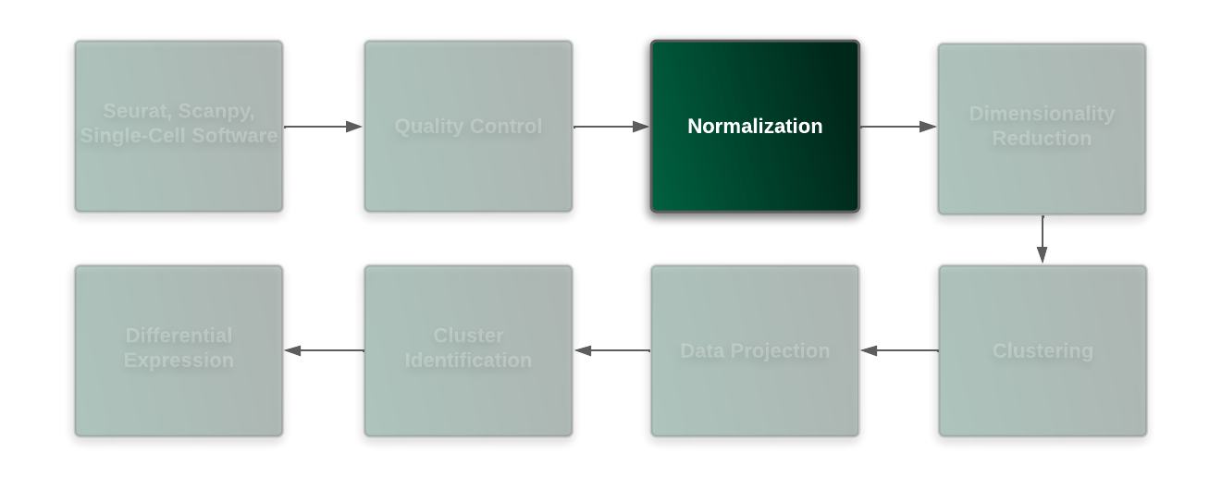
Roadmap (Normalization)

Slide 25
Roadmap (Normalization)
Inherent bias present.
Sequencing depth, gene length, etc.
Normalization removes this bias so that the differences we see from the cells are biological differences.

Slide 26
Roadmap (Normalization)
Log-Normalization
Counts for each cell are divided by total cell counts, and multiplied by a scale factor. They are then log-transformed.
SCTransform (“V2 flavor”)
Normalization Using a Regularized Negative Binomial Model
Most commonly used normalization method.

Slide 27
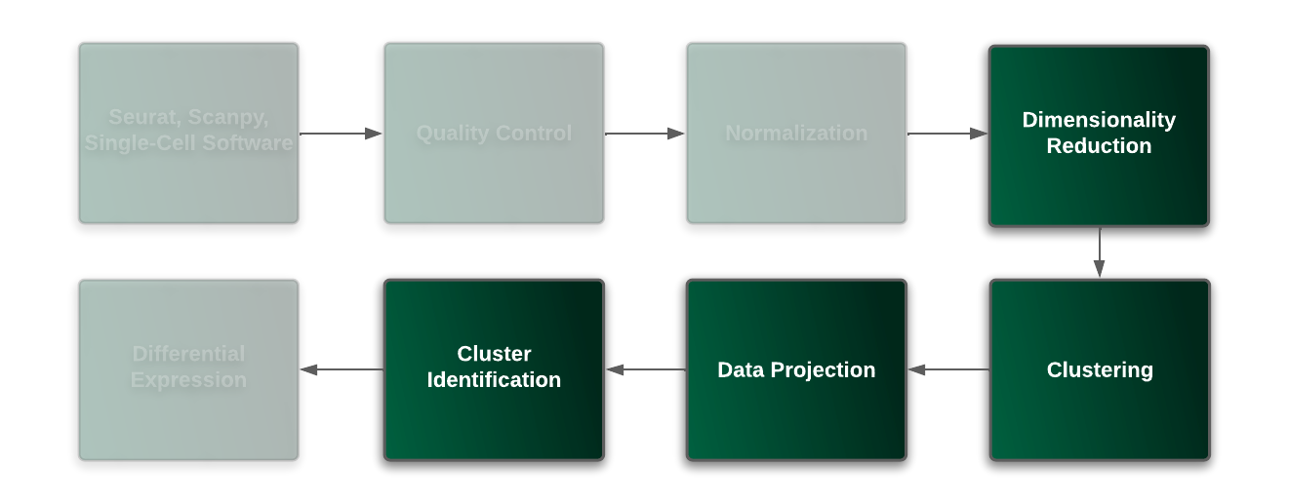
Roadmap (Dimensionality Reduction, Cluster Identification)

Slide 28
Roadmap (Dimensionality Reduction, Cluster Identification)
Dimensionality Reduction: Capturing the core variability within the data-set.
Clustering: Finding patterns with cells.
Data Projection/Cluster Identification: Visualizing cell populations and identifying marker genes in each cluster that represent a cell-type.

Slide 29
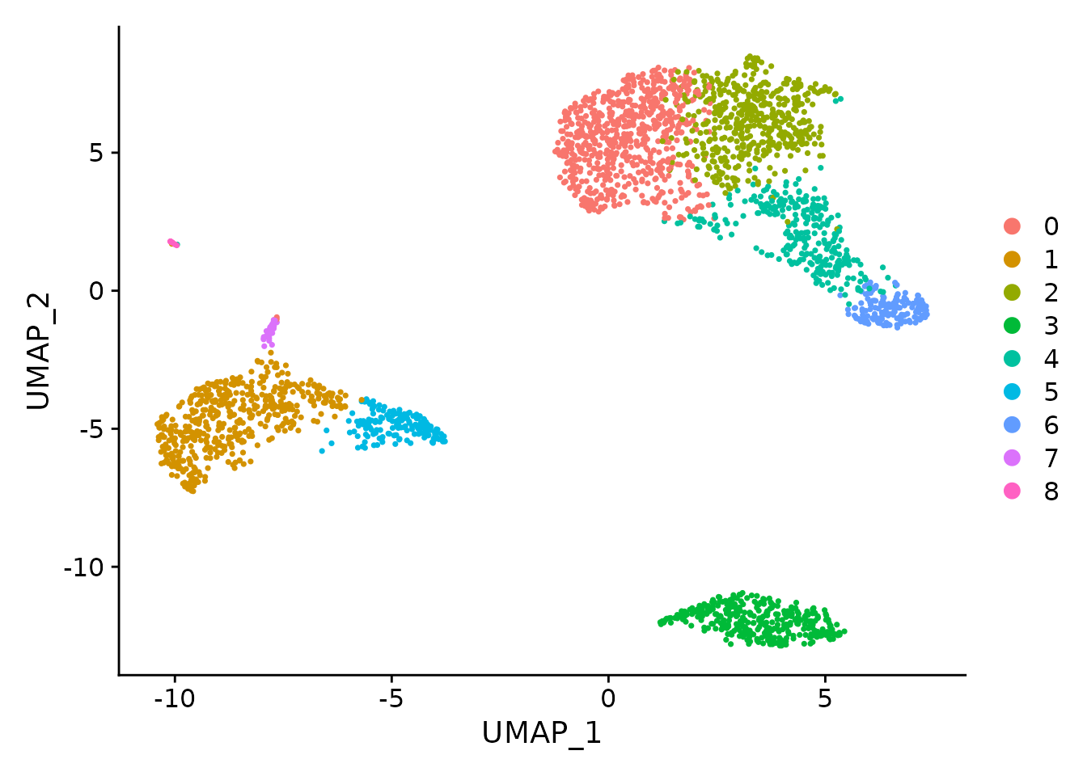
RoadMap (Data Projection - UMAP)
UMAP
“data projection.”
Non-linear dimensionality reduction technique.
Visualizes high-dimensional data in low dimensional space.
TSNE
Doesn’t preserve the data as well
Computational speed, etc..
https://pair-code.github.io/understanding-umap/

Slide 30
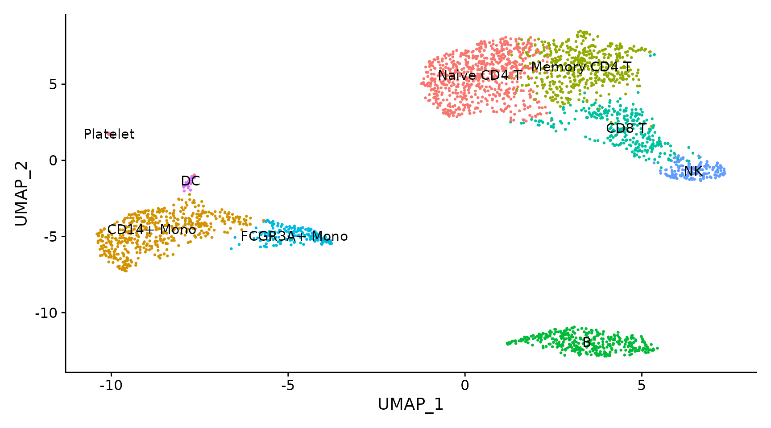
Roadmap (Cluster Identification)

Slide 31
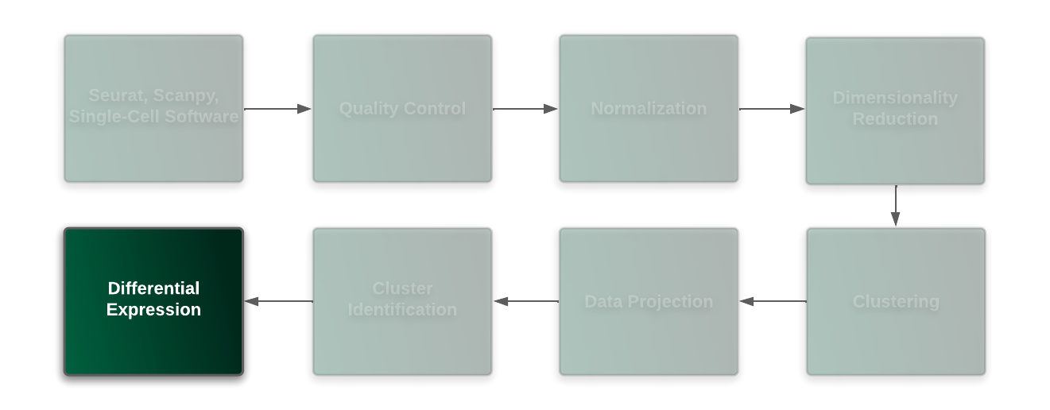
Roadmap (Differential Expression)

Slide 32
Roadmap (Differential Expression)
Differential expression in single-cell can proceed in two ways..

Slide 33
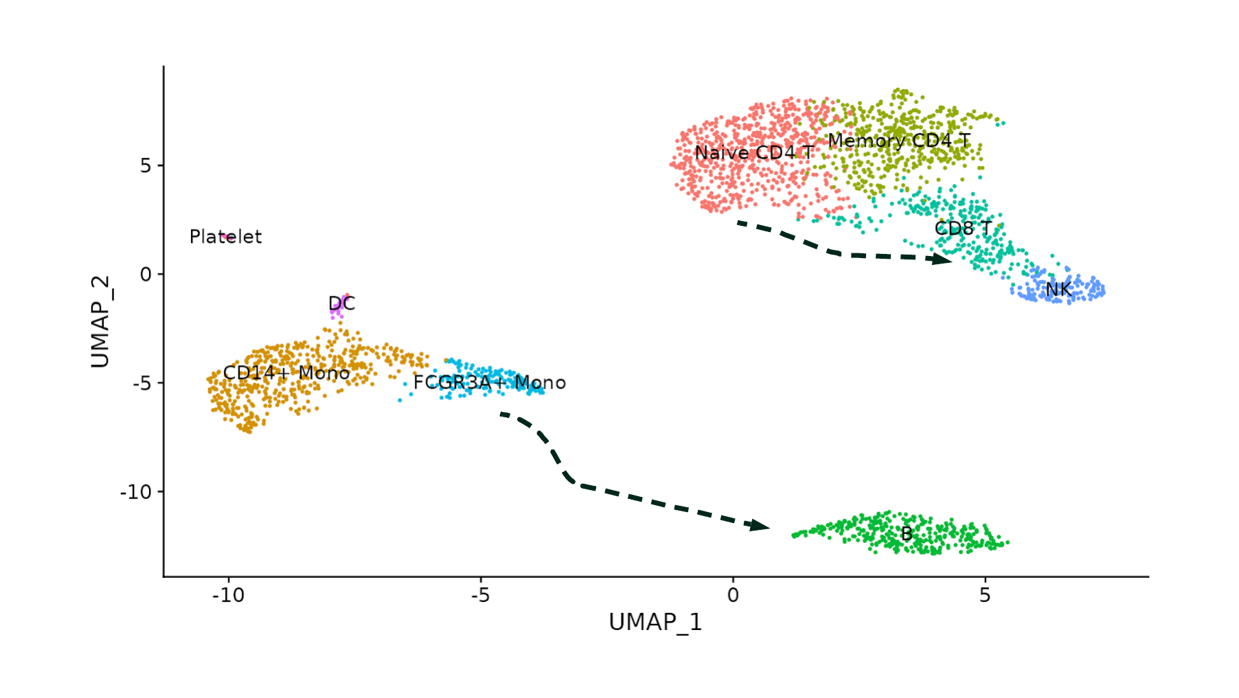
Cluster-Specific DE

Slide 34
Differential Expression Between Phenotypes/Conditions

Slide 35
Pseudobulk
Aggregation of single-cell counts by cell type for comparison across conditions.
Allows you to conduct phenotype comparisons (disease vs normal.)
Useful for situations with lower counts.
Able to assess biological variation to a greater extent.

Slide 36
Recap on scRNA-Seq
scRNA-seq allows for novel identification of cell populations, a look into the cell-specific expression landscape, and ability to look at tissue-wide differences (pseudobulk.)
Single-Cell RNA-Seq is evolving fast.
Multimodal approach - simultaneously measure transcriptomics and cell-surface protein, chromatin accessibility, etc.

Slide 37
Links To Sample Data
10X Genomics Data
Seurat Data
Seurat Data Package

Slide 38
U-BDS
Data Science Office Hours
Thursdays 3:30-4:00
Slack ID: C0118620WC8
Training Guides
https://github.com/U-BDS/training_guides

